Slide 1
Advanced Trauma Life Support (ATLS®) Summary of 10th Edition Changes
September 2018

Slide 2
Introduction
New to 10th Edition:
UK m-learning Course
UK Scenario stations: Completely revised skills stations based on unfolding scenarios (contextualised learning).
New Chapter focusing on Team Resource Management in ATLS.
All chapters contain section focusing on teamwork as it relates to the chapter.
All chapters contain section identifying pitfalls and possible preventative measures to avoid the pitfall.
Addition of skills in local haemorrhage control including wound packing and application of a tourniquet.
Update of terminology for spinal immobilization to restriction of spinal motion.

Slide 3
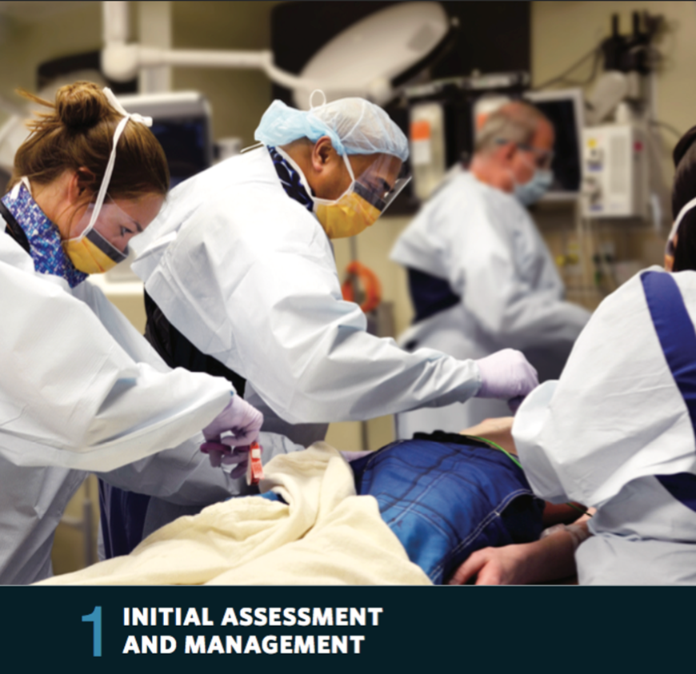

Slide 4
Chapter 1 Summary of changes
1 L of isotonic solution - if unresponsive should receive blood
Judicious fluids, avoid aggressive resuscitation before control of bleeding
Tranexamic acid
Coagulopathy
NEXUS and Canadian C- Spine Rule
MIST
To perform effectively, each trauma team should have one member serving as the team leader.

Slide 5
1L of isotonic solution, if unresponsive, should receive blood
A bolus of 1 L of an isotonic solution may be required to achieve an appropriate response in an adult patient. If a patient is unresponsive to initial crystalloid therapy, he or she should receive a blood transfusion.
Judicious fluids, avoid aggressive resuscitation before control of bleeding
Fluids are administered judiciously, as aggressive resuscitation before control of bleeding has been demonstrated to increase mortality and morbidity.

Slide 6
Tranexamic acid
Some severely injured patients arrive with coagulopathy already established, which has led some jurisdictions to administer tranexamic acid pre-emptively in severely injured patients.
European and American military studies demonstrate improved survival when tranexamic acid is administered within 3 hours of injury. When bolused in the field follow up infusion is given over 8 hours in the hospital (see Guidance Document for the Prehospital Use of Tranexamic Acid in Injured Patients).
Coagulopathy
Severely injured trauma patients are at risk for coagulopathy, which can be further exacerbated by resuscitative measures. This condition potentially establishes a cycle of ongoing bleeding and further resuscitation, which can be mitigated by use of massive transfusion protocols with blood components administered at predefined low ratios (see Chapter 3: Shock)

Slide 7
NEXUS and Canadian C-Spine Rule
Facilitates avoidance of imaging of cervical spine in patients defined as low risk by NEXUS (National Emergency X-Radiography Utilization Study) or CCR (Canadian C-Spine Rule)

Slide 8
M I S T
M echanism (and time) of injury
I njuries found and suspected
S ymptoms and Signs
T reatment initiated

Slide 9
To perform effectively, each trauma team should have one member serving as the team leader.
The team leader supervises, checks, and directs the assessment; ideally he or she is not directly involved in the assessment itself.
The team leader is not necessarily the most senior person present, although he or she should be trained in ATLS and the basics of medical team management.
The team leader supervises the preparation for the arrival of the patient to ensure a smooth transition from the prehospital to hospital environment.
He or she assigns roles and tasks to the team members, ensuring that each participant has the necessary training to function in the assigned role.

Slide 11
Chapter 2 Summary of changes
Drug-Assisted Intubation replaces RSI
(UK view of endotracheal intubation skill teaching)
Surgical cricothyroidotomy
Most trauma victims require the individual attention of an airway manager.

Slide 12
Cricothyroidotomy
STEP 6. Make a 2- to 3-cm vertical skin incision over the cricothyroid membrane and, using the non-dominant hand from a cranial direction, spread the skin edges to reduce bleeding. Re-identify the cricothyroid membrane and then incise through the membrane transversely. Caution: Do not cut or remove the cricoid and/or thyroid cartilages.
ATLS provider manual p343 APPENDIX G Skills.
UK guidelines recommend the use of a bougie to aid insertion into trachea.

Slide 13
Most trauma victims require the individual attention of an airway manager.
The team leader should establish the degree of practical expertise of the airway manager.
If prehospital information suggests that the patient will require a definitive airway, it may be wise to draw up appropriate drugs for sedation and drug-assisted intubation before the patient arrives.
Equipment for managing the difficult airway should also be located within easy access of the resuscitation room.
Patients may require transfer to the CT scan, operating room, or ICU. Therefore, the team leader should clarify who will be responsible for managing a patient’s airway and ventilation after intubation.

Slide 15
Chapter 3 Summary of changes
1 L warm fluid for initial resuscitation
Base excess added to Class of Hypovolemic Shock table
Blood and blood products used early
Coagulopathy
Tranexamic acid
Preferred site for adult IO access is the proximal humerus
One of the most challenging situations a trauma team faces is managing a trauma victim who arrives in profound shock.

Slide 17
Blood and blood products used early
Early resuscitation with blood and blood products must be considered in patients with evidence of class III and IV haemorrhage.
Early administration of blood products at a low ratio of packed red blood cells to plasma and platelets can prevent the development of coagulopathy and thrombocytopenia.
Massive transfusion defined as > 10 units pRBC in 24 hours or more than 4 units in 1 hour.
Coagulopathy
Thromboeleastography (TEG) and Rotational thromboelastometry (ROTEM) can be helpful in determining the clotting deficiency and appropriate blood components to correct the deficiency.
The provider course emphasizes recognition and reversal of coagulopathy secondary to medication.

Slide 18
Tranexamic acid
Some jurisdictions administer tranexamic acid in prehospital setting to severely injured patients in response to studies that demonstrated improved survival when this drug (1 gram) is administered within 3 hours of injury.
The first dose is usually given over 10 minutes and is administered in the field.
The follow up dose of 1 gram is given over 8 hours.
IO Access: Humerus
In adults recommended IO access site is the proximal humerus.
Less painful
Better circulation time
Provider manual APPENDIX G Skills p351

Slide 19
One of the most challenging situations a trauma team faces is managing a trauma victim who arrives in profound shock.
The team leader must direct the team decisively and calmly, using ATLS principles.
Identifying and controlling the site of haemorrhage with simultaneous resuscitation involves coordinating multiple efforts.
The team leader must ensure that rapid intravenous access is obtained even in challenging patients.
The decision to activate the massive transfusion protocol should be made early to avoid the lethal triad of coagulopathy, hypothermia, and acidosis.
The team must be aware of the amount of fluid and blood products administered, as well as the patient’s physiological response, and make necessary adjustments.
The team leader ensures that the areas of external haemorrhage are controlled and determines when to perform adjuncts such as chest x-ray, pelvic x-ray, FAST, and/or diagnostic peritoneal lavage (DPL).
Decisions regarding surgery or angioembolization should be made as quickly as possible and the necessary consultants involved.
When required services are unavailable, the trauma team arranges for rapid, safe transfer to definitive care.

Slide 21
Chapter 4 Summary of changes
Primary Survey: life-threatening injuries
Tracheobronchial injuries included
Flail chest removed
Diagnosis and decompression of tension pneumothorax
Algorithm for Traumatic Circulatory Arrest
Chest tube size for haemothorax changed
Medical management of aortic rupture; 𝛽-blocker
The team leader must quickly establish the competencies of team members in performing needle decompression and chest drainage techniques.

Slide 22
Primary Survey: life-threatening injuries
Airway
Airway obstruction (laryngotracheal injury)
Tracheobronchial tree injury
Breathing
Tension pneumothorax
Open pneumothorax
Circulation
Massive haemothorax
Cardiac tamponade
Traumatic Circulatory Arrest

Slide 23
Tension pneumothorax
When ultrasound is available, tension pneumothorax can be diagnosed using an extended FAST (eFAST) examination.
Adult needle thoracocentesis now in 5th IC space just anterior to mid-axillary line
Paediatric remains 2nd IC space
Finger thoracostomy is an alternative approach for emergency decompression.

Slide 25
Chest tube size
An acute haemothorax that is large enough to appear on a chest x-ray may be treated with a 28-32 French gauge chest tube (previously 36-40 recommended).
Aortic rupture
Heart rate and blood pressure control can decrease the likelihood of rupture of traumatic aortic aneurysm.
If no contraindications exist use a short-acting beta-blocker
heart rate < 80 beats per minute
mean arterial pressure of 60-70 mm Hg.

Slide 26
The team leader must:
Quickly establish the competencies of team members in performing needle decompression and chest drainage techniques.
Consider the potential need for bilateral chest drains and assess team resources accordingly.
Recognize patients who have undergone prehospital intervention, such as needle decompression or open chest drainage, assess the patient’s response, and determine the need for additional timely interventions.
Recognize when open thoracotomy will benefit the patient and ensure that the capability exists for safe transport without delay to a skilled surgical facility.

Slide 28
Chapter 5 Summary of changes
Blast mechanism included in addition to penetrating and blunt injury.
Palpation of the prostate gland is not a reliable sign of urethral injury.
Flowchart for pelvic fractures with haemorrhage
The team must be able to determine the priorities of treatment and identify which of perhaps several simultaneous studies and interventions need to be performed.

Slide 29
Blast injury
Blast injury from explosive devices occurs through several mechanisms:
Penetrating fragment wounds.
Blunt injuries from the patient being thrown or struck by projectiles.
Patients close to the source of the explosion can incur additional injuries to the tympanic membranes, lungs, and bowel related to blast overpressure.

Slide 31
The team must be able to determine the priorities of treatment and identify which of perhaps several simultaneous studies and interventions need to be performed.
The team leader must recognize the need to apply a pelvic binder and ensure its correct placement while continuing to evaluate the patient’s response to resuscitation.
Ensure that team members work effectively and swiftly to avoid any delay in the transfer of a patient with abdominal injury to definitive care.

Slide 33
Chapter 6 Summary of changes
Mild Head Trauma Severity replaces Minor HTS.
The new GCS score is introduced
BP management guidance introduced.
Anticoagulant reversal guidance
Seizure prophylaxis.
The team leader must ensure that the team manages a primary brain injury to the best possible outcome by preventing secondary brain injury.

Slide 35
BP management
Evidence based treatment guidelines introduced: including the BTF 4th edition TBI guidelines and the ACS TQIP best practices in the management of TBI
TBI guideline L3:
Maintaining SBP at
>= 100 mm Hg for patients 50 to 69 years
>= 110 mm hg for patients 15 to 49 or >70 years
Considered to decrease mortality and improve outcomes.

Slide 36
ACS TQIP Best Practices in the Management of Traumatic Brain Injury

Slide 38
Seizure prophylaxis
Introduced evidence based guideline level II A regarding use of seizure prophylaxis.
Phenytoin is recommended to decrease the incidence of early PTS (within 7 days of injury).
However, early PTS have not been associated with worse outcomes.
Phenytoin and Valproate are NOT recommended for late PTS

Slide 39
The team leader must:
Ensure that the team manages a primary brain injury to the best possible outcome by preventing secondary brain injury.
Recognize the importance of managing the airway to ensure patients with head injuries do not experience unnecessary hypoxia.
Recognize the need to involve neurosurgical expertise at an appropriate stage and in a timely fashion, particularly when a patient requires surgical intervention.
Ensure the timely transfer of patients with TBI to a trauma center when it is required.
Ensure that patients with significant head injuries are transferred to facilities where they can be appropriately monitored and observed closely for signs of deterioration.
Because some patients require neurosurgical intervention early, be able to prioritize the treatment of brain injury with other life- threatening injuries such as haemorrhage. Manage the discussion between representatives of different surgical specialties to ensure the patient’s injuries are treated in the correct sequence.

Slide 41
Chapter 7 Summary of changes
Restriction Of Spinal Motion (ROSM) replaces spinal immobilization.
New myotome diagram.
CCR (Canadian C-Spine Rule) and NEXUS (National Emergency X-Radiography Utilization Study)
UK radiology skills
The trauma team must ensure adequate spinal motion restriction during the primary and secondary surveys, as well as during transport of patients with proven or suspected spinal injury.

Slide 45
The trauma team must ensure adequate spinal motion restriction during the primary and secondary surveys, as well as during transport of patients with proven or suspected spinal injury.
As long as the patient’s spine is protected, a detailed examination can safely be deferred until the patient is stable.
Although there are often many competing clinical interests, the trauma team must ensure that a complete and adequate exam- ination of the spine is performed. The team leader should decide the appropriate time for this exam.

Slide 47
Chapter 8 Summary of changes
External haemorrhage control (tourniquet and packing)
Weight based IV antibiotic regimen
Bilateral femur fractures a risk factor for complications and death.
Musculoskeletal injuries, especially open fractures, often appear dramatic and can potentially distract team members from more urgent resuscitation priorities.

Slide 49
Bilateral femoral fractures
Patients with bilateral femur fractures are at higher risk for significant blood loss, severe associated injuries, pulmonary complications, multiple organ failure, and death.
These fractures should alert the clinician to the possibility of associated injures because of the significant force required to result in the injury.

Slide 50
Musculoskeletal injuries, especially open fractures, often appear dramatic and can potentially distract team members from more urgent resuscitation priorities.
Because potentially life-threatening musculoskeletal injuries can be detected during the assessment of circulation, the team leader must rapidly direct the team to control external haemorrhage using sterile pressure dressings, splints, or tourniquets as appropriate.
More than one team member may be required to apply a traction splint
The team must be able to recognize limb- threatening injuries and report these accurately to the team leader so decisions can be made for managing these injuries in conjunction with life-threatening problems involving airway, breathing, and circulation.
Ensure that the trauma team performs a complete secondary survey, so injuries are not overlooked. Occult injuries are particularly common in patients with a depressed level of consciousness, and the team leader should ensure timely re-evaluation of the limbs to minimize missed injuries.

Slide 52
Chapter 9 Summary of changes
Due to concerns about over-resuscitation when using Parkland formula:
Fluid resuscitation for patient with deep partial and full thickness burns involving > 20% BSA:
Adult: 2ml/kg/% TBSA
Paediatric: 3ml/kg/%TBSA.
50% in the first 8 hours after the burn.
50% in subsequent 16hr.
Fluid is titrated based on adequacy of the urine output.
Avoid fluid boluses unless the patient is hypotensive.
The team leader must ensure that the trauma team recognizes the unique aspects of applying the ATLS principles to treating burn-injured patients.

Slide 54
The team leader must:
Ensure that the trauma team recognizes the unique aspects of applying the ATLS principles to treating burn-injured patients.
Help the team recognize the importance of limiting exposure to minimize hypothermia in the patient and infection of the burn.
Encourage the trauma team to communicate early and regularly regarding concerns about the challenges of resuscitating a burn- injured patient (e.g., IV access and need for escharotomies).

Slide 56
Chapter 10 Summary of changes
Note no change in site for needle decompression in children 2nd intercostal space mid clavicular line.
Fluid resuscitation: Packed rbcs should be considered after the second or third bolus.
PECARN criteria for head CT
Ideally, injured children are cared for in settings that have a paediatric trauma team

Slide 57
Paediatric fluid resuscitation
20ml/kg bolus followed by one or two additional boluses.
Packed rbcs should be considered after the second or third bolus.
Damage control resuscitation in children represents a move toward limiting crystalloid resuscitation.
20 ml/kg bolus
10-20 ml/kg of Prbc
10-20 ml/kg of fresh frozen plasma and platelet as part of massive transfusion protocol
No survival advantage has been demonstrated in literature

Slide 58
Paediatric Emergency Care Applied Research Network (PECARN) criteria for head CT
A<2yr
B>2yr

Slide 59
Ideally, injured children are cared for in settings that have a paediatric trauma team composed of a physician with expertise in managing paediatric trauma, paediatric specialist physicians, and paediatric nurses and staff.
Team members should be assigned specific tasks and functions during the resuscitation to ensure an orderly transition of care.
The reality is that most injured children will initially be treated in a facility with limited paediatric specialty resources. An adult trauma team may be responsible for the care of injured children and must provide the following:
A trauma team leader who has experience in the care of injured patients and is familiar with the local medical resources available to care for injured children
A provider with basic airway management skills
Access to providers with advanced paediatric airway skills
Ability to provide paediatric vascular access via percutaneous or intraosseous routes
Knowledge of paediatric fluid resuscitation
Appropriate equipment sizes for a range of different ages
Strict attention to drug doses
Early involvement of a surgeon with paediatric expertise, preferably a paediatric surgeon
Knowledge and access to available paediatric resources (paediatrician, family medicine) to help manage paediatric-specific comorbidities or issues
Inclusion of the child’s family during the emergency department resuscitation and throughout the child’s hospital stay
It is particularly important to debrief after a paediatric trauma case. Team members and others present in the resuscitation room may be deeply affected by poor outcomes for children. Appropriate mental health resources should be available.

Slide 61
Chapter 11 Summary of changes
Pre-existing conditions impact morbidity and mortality.
Mortality from pelvic fracture 4 X higher in older than younger patients
Need for blood transfusion even with stable fracture is higher
Longer hospital stays and less return to independent lifestyles
Trauma teams are increasingly managing trauma in the elderly population.

Slide 62
Patients with one or more of these PECs twice as likely to die as those without:
cirrhosis
congenital coagulopathy
chronic obstructive pulmonary disease
ischemic heart disease
diabetes mellitus

Slide 63
Trauma teams are increasingly managing trauma in the elderly population.
Because of pre-existing medical conditions and the potential complications of anticoagulant and antiplatelet drug therapy, successful management of geriatric trauma remains challenging.
A trauma team with an understanding of the unique anatomical and physiological changes related to aging can have a positive impact on patient outcome.
Early activation of the trauma team maybe required for elderly patients who do not meet traditional criteria for activation. A simple injury, such as an open tibia fracture, in a frail elderly person may quickly become life-threatening.
The effect of cardiac drugs, such as beta blockers, may blunt the typical physiological response to haemorrhage, making interpretation of traditional vital signs difficult. The team member responsible for managing circulation must ensure that the team leader is made aware of even minor changes in physiological parameters, and he or she should assess for perfusion status to promptly identify and manage catastrophic haemorrhage.
The outcomes for elderly trauma patients are often poor. The team leader must consider patients’ advanced directives and recognize the patient's goals of care. Often, members of the team provide opinions or suggestions that may be helpful in caring for patients in these difficult situations.

Slide 65
Chapter 12 Summary of changes
Indication of amniotic fluid leak is vaginal fluid pH of > 4.5
The team must remember that, although there are two patients, the team’s primary mission is to ensure optimal resuscitation of the mother.

Slide 66
The team leader should remind the team of the major anatomical and physiological changes associated with pregnancy that may affect evaluation of the pregnant injured patient.
The team must remember that, although there are two patients, the team’s primary mission is to ensure optimal resuscitation of the mother.
The team leader should notify the on-call obstetrician and the obstetrics unit of the impending arrival of an injured pregnant patient as soon as possible while continuing to direct the overall resuscitation.
The team must maintain an appropriately high index of suspicion for the presence of intimate partner violence, carefully documenting all injuries.

Slide 68
Chapter 13 Summary of changes
Emphasis on avoidance of CT scans in primary hospital.
ABC-SBAR template to facilitate communication.
When the level of care exceeds the capabilities of the treating facility, the trauma team leader must work quickly and efficiently to initiate and complete transfer to definitive care.

Slide 69
Avoidance of CT scans in primary hospital
A significant portion of trauma patients transferred to regional trauma centres undergo CT scanning at the primary hospital.
Much of the time delay between injury and transfer is related to performing diagnostic studies despite lack of a surgeon to provide definitive care.
Frequently, CT scans done before transfer are repeated upon arrival to the trauma centre.
Multiple scans result in increased radiation exposure and additional hospital costs as well as a delay in transfer to definitive care.

Slide 70
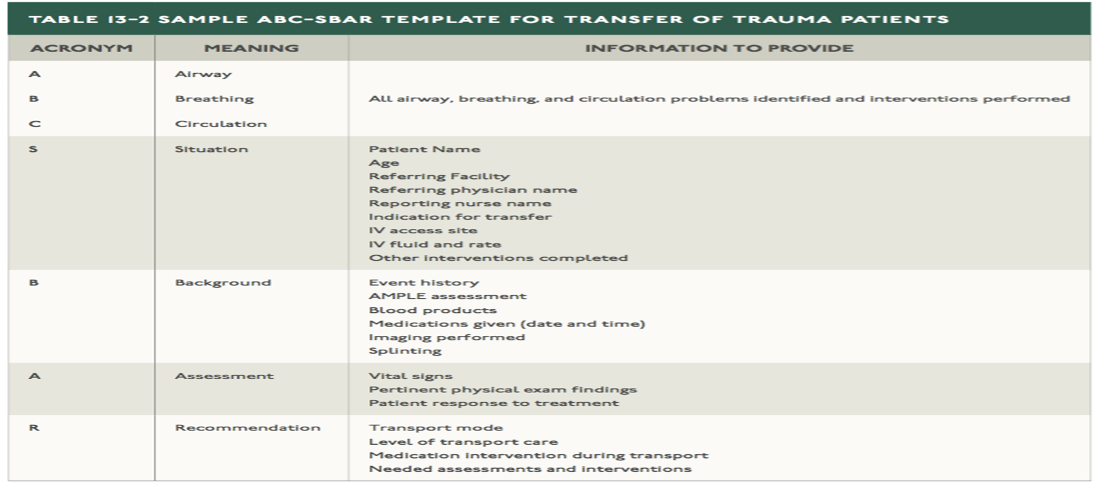
ABC-SBAR template to facilitate communication between transferring and accepting physicians:

Slide 71
When the level of care exceeds the capabilities of the treating facility, the trauma team leader must work quickly and efficiently to initiate and complete transfer to definitive care.
Other team members can assist the team leader by communicating with the receiving facility while the trauma team leader remains focused on the patient.
The team leader ensures rapid preparation for transfer by limiting tests (particularly CT scans) to those needed to treat immediately life- threatening conditions that can be managed by specialists and facilities at hand.

