Slide 1
Radiographic Adjuncts to the Assessment and Management of the Trauma Patient Scenarios X-rays Reflective self-assessment
April 2020
© The Royal College of Surgeons of England 2020. All rights reserved

Slide 2
Adjuncts
Relevance of content
Adjuncts to the primary survey include investigations that may be performed during assessment and resuscitation. Many patients will undergo a ‘trauma CT’ but some plain film x-rays may be undertaken in the resuscitation room.
Chest x-rays can confirm a clinical diagnosis and can also be repeated to confirm a response to an intervention (placement of a chest drain for example).
Pelvic x-rays are, similarly, of use in determining a cause for haemorrhagic shock.

Slide 3
Adjuncts
Learning Outcomes - by the end of this module you will be able to:
Use structured approaches to examine chest and pelvis x-rays.
Use the taught approaches to identify abnormalities relevant to the primary survey.

Slide 4
Interpretation of chest x-rays
Suggested approach:
Check patient, date and time of image
Look:
A - Airway (trachea, carina, main bronchi), alignment and adequacy
B - Breathing (lung fields, pleural margins and space)
C - Cardiac silhouette and mediastinal contour
D - Diaphragm (visualised, hollow organs in thoracic cavity?)
E - Everything else: bones, soft tissues and equipment (lines and drains) and other foreign bodies

Slide 5
CXR 1
Scenario 1
A 30 year old male has been involved in a high speed motor vehicle collision. He has bruising across his anterior chest wall from a seat belt but a normal chest examination.
A chest x-ray is taken
Using the suggested approach examine the x-ray on the next slide (correct interpretation will follow):

Slide 6
CXR 1

Slide 7
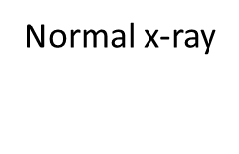
CXR 1

Slide 8
CXR 2
Case progression
Shortly after admission the patient’s conscious level deteriorates with a GCS of 7. He is intubated. Chest examination reveals decreased air entry on the left. SpO₂ remains low (90%). A repeat chest x-ray is taken.
Using the suggested approach examine the x-ray on the next slide (correct interpretation will follow):

Slide 9
CXR 2

Slide 10
CXR 2

Slide 11
CXR 3
Scenario 2
A 10 year old boy is admitted after being crushed between two cars. He is in respiratory distress with hyper-resonant right chest and no air entry on that side.
After needle decompression of a presumed tension pneumothorax an intercostal chest drain is inserted and a chest x-ray is obtained.
Using the suggested approach examine the x-ray on the next slide (correct interpretation will follow):

Slide 12
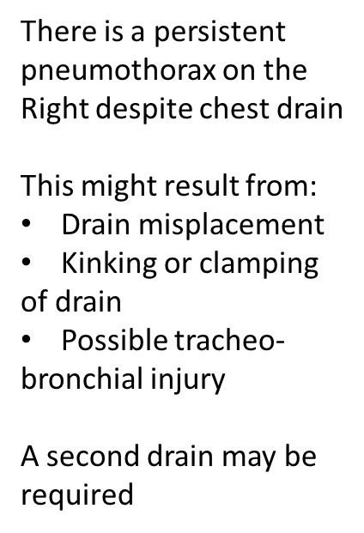
CXR 3

Slide 13
CXR 3

Slide 14
CXR 4
Scenario 3
A 69 year old woman is admitted after a motor vehicle collision with prolonged extraction time. She has been intubated and is ventilated with 100% oxygen. SpO₂ is reduced (92%).
Chest examination reveals crepitus and surgical emphysema on the left with corresponding decreased air entry. An intercostal chest drain is inserted and a chest x-ray is obtained.
Using the suggested approach examine the x-ray on the next slide (correct interpretation will follow):

Slide 15
CXR 4

Slide 16
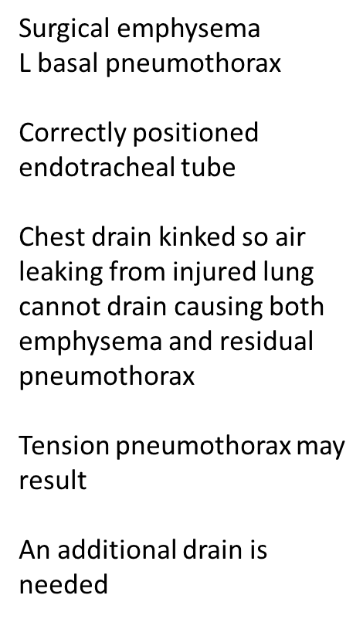
CXR 4

Slide 17
CXR 5
Scenario 4
A 44 year old male is admitted after a motorcycle collision with a tree. At the scene of the accident he was hypotensive and complaining of severe chest pain. His blood pressure is now 100/70 mmHg. He has been intubated and is ventilated with 100% oxygen. SpO₂ is 98%.
A chest x-ray is obtained.
Using the suggested approach examine the x-ray on the next slide (correct interpretation will follow):

Slide 18
CXR 5

Slide 19
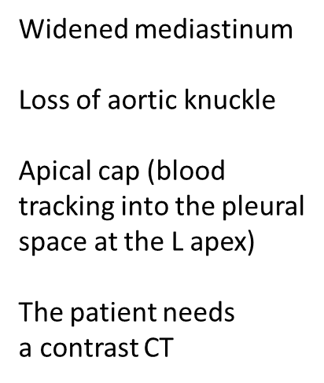
CXR 5

Slide 20
CXR 5

Slide 21
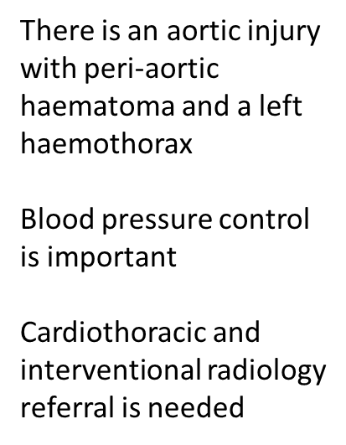
CXR 5

Slide 22
CXR 6
Scenario 5
A 33 year old male is admitted after being crushed by a forklift truck. He complains of severe abdominal and chest pain and is short of breath. His airway is patent but SpO₂ is 93% with supplemental oxygen.
A chest x-ray is obtained.
Using the suggested approach examine the x-ray on the next slide (correct interpretation will follow):

Slide 23
CXR 6

Slide 24
CXR 6
The L hemi- diaphragm
cannot be seen
There is a hollow viscus
in the L chest (abnormal
gas seen)
The trachea is deviated
to the right
Surgical repair of
disrupted diaphragm is
needed after all life-
threatening injuries are
treated

Slide 25
CXR 7
Scenario 6
A 28 year old male builder has fallen 30 feet from scaffolding onto a concrete surface. He is distressed and breathless and complains of severe left chest pain.
A chest x-ray is taken during the primary survey.
Using the suggested approach examine the x-ray on the next slide (correct interpretation will follow):

Slide 26
CXR 7

Slide 27
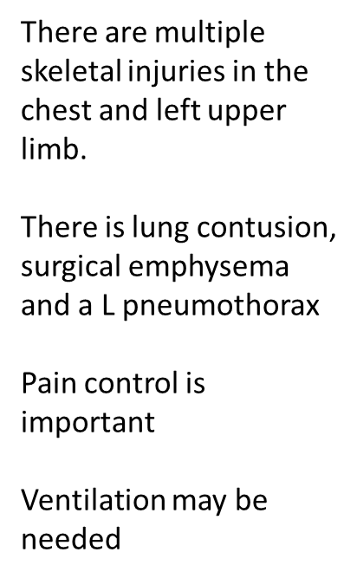
CXR 7

Slide 28
CXR summary
A CXR can be used to confirm injuries suspected on clinical examination of the patient.
The CXR can also be used to determine the correct positioning of devices such as endotracheal tubes within the trachea and chest drain position within the thoracic cavity.
The presence of residual haemothorax or pneumothorax might indicate the need for another intervention like placement of a second CT or operative intervention.
CT scanning can further elucidate signs detected on plain radiographs.
FAST can also help examine the pericardial sac but can be hindered by surgical emphysema.

Slide 29
Interpretation of pelvic x-rays
Suggested approach:
Check patient, date and time of image.
Look:
Three rings; trace the main pelvic ring and two obturator foramina - if disrupted think fracture and look for a second disruption in the ring.
Joint spaces; sacroiliac joint spaces should be equal (2-4mm). Check L5 transverse processes which may also fracture with sacroiliac disruption.
Symphysis pubis should be ≤ 5mm, (≤10mm in pregnancy).
If either joint space is widened, think main pelvic ring fracture.
Acetabulum; check bilaterally for interruption and femoral dislocation.

Slide 30
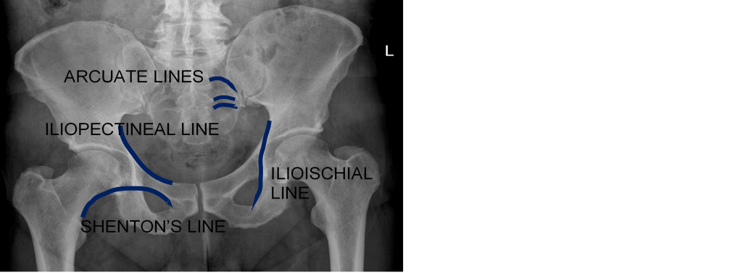
Interpretation of pelvic x-rays
Suggested approach cont’d:
Inspect iliopectineal line, ilioischial line.
Acetabular roof, anterior rim, posterior rim and teardrop.
if iliopectineal line disrupted, think anterior column fracture
if ilioischial line disrupted, think posterior column fracture
if teardrop displaced, think occult acetabular fracture
Sacrum; the arcuate lines should be smooth and symmetrical - look for fracture.
Proximal femur; check the femoral head and neck for disruption bilaterally. Check Shenton’s line.

Slide 31
Interpretation of pelvic x-rays

Slide 32
PXR 1
Scenario P1
A 46 year old woman has been involved in a motor vehicle collision. Primary survey reveals no immediately life-threatening injuries. She complains of pelvic pain. An AP film of the pelvis is taken.
Using the suggested approach examine the x-ray on the next slide (correct interpretation will follow):

Slide 33
PXR 1

Slide 34
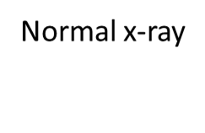
PXR 1

Slide 35
PXR 2
Scenario P2
A 40 year old woman has been involved in a motor vehicle collision. The car rolled over and she was unrestrained. She has signs of haemorrhagic shock. An x-ray of the pelvis is taken.
Using the suggested approach examine the x-ray on the next slide (correct interpretation will follow):

Slide 36
PXR 2

Slide 37
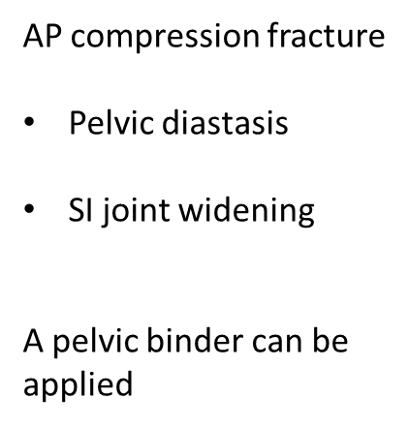
PXR 2

Slide 38
PXR 3
Case progression
A pelvic binder is applied and another x-ray is taken.
Using the suggested approach examine the X-ray on the next slide (correct interpretation will follow):

Slide 39
PXR 3

Slide 40
PXR 3

Slide 41
PXR
Self-assessment questions (suggested responses on next slide):
What is the purpose of applying a pelvic binder?
If the patient remains hypotensive, what should we do next? How do we differentiate where the bleeding is coming from? What is the next step in treatment?

Slide 42
PXR
The pelvic volume needs reducing to tamponade venous bleeding and decrease pain.
The pelvis may not be the only source of bleeding.
Early surgical consultation is needed along with ongoing resuscitation.
FAST may be useful to evaluate for intra-abdominal bleeding. If FAST is negative, consider angiography. Otherwise, the patient may need a laparotomy.
Interventional radiology should also be considered

Slide 43
PXR 4
Scenario P3
An 82 year old woman has fallen down stairs at home. Primary survey reveals no immediately life-threatening injuries. She complains of pelvic pain. An AP film of the pelvis is taken.
Using the suggested approach examine the x-ray on the next slide (correct interpretation will follow):

Slide 44
PXR 4

Slide 45
PXR 4
Lateral compression
injury
Bilateral inferior and
superior pubic ramus
fractures

Slide 46
PXR 5
Scenario P4
A 32 year old male jumped from a fourth storey balcony. He is unconscious and has signs of haemorrhagic shock. An AP film of the pelvis is taken.
Using the suggested approach examine the x-ray on the next slide (correct interpretation will follow):

Slide 47
PXR 5

Slide 48
PXR 5

Slide 49
PXR 6
Scenario P5
A 28 year old female motorcyclist has hit a wall at speed. She complains of pelvic pain and on examination there is significant perineal bruising. An AP film of the pelvis has been taken. There is concern regarding possible urethral injury.
Self-assessment question (suggested responses on next slide):
What investigation might confirm a urethral injury?

Slide 50
PXR 6
A retrograde urethrogram should be performed.
Using the suggested approach examine the x-ray on the next slide (correct interpretation will follow):

Slide 51
PXR 6

Slide 52
PXR 6
Fractures of all four pubic
rami and diastasis of pubic
symphysis
A urethrogram has been
performed and shows
leakage of contrast from
the urethra

Slide 53
PXR 7
Scenario P6
40-year-old motorcyclist with TBI. In haemorrhagic shock. Obvious unstable pelvis with haematuria and perineal bruising.
Using the suggested approach examine the x-ray on the next slide (correct interpretation will follow):

Slide 54
PXR 7

Slide 55
PXR 7
Severe disruption of the Right
hemipelvis and fractures of
the Left pubic rami
Urethrogram was normal
Cystogram shows compression
of the bladder by haematoma
The pelvis has been packed
to control bleeding

Slide 56
Pelvic x- ray summary
A pelvic x-ray can be used to confirm injuries suspected on clinical examination of the patient.
The pelvic x-ray can also be used to demonstrate closure of the pelvis with a binder.
Urethral injury can be confirmed with a retrograde urethrogram.

Slide 57
Adjuncts
You have learned:
To use structured approaches to examine chest and pelvis x-rays.
To use the taught approaches to identify abnormalities relevant to the primary survey.

